Slide 1

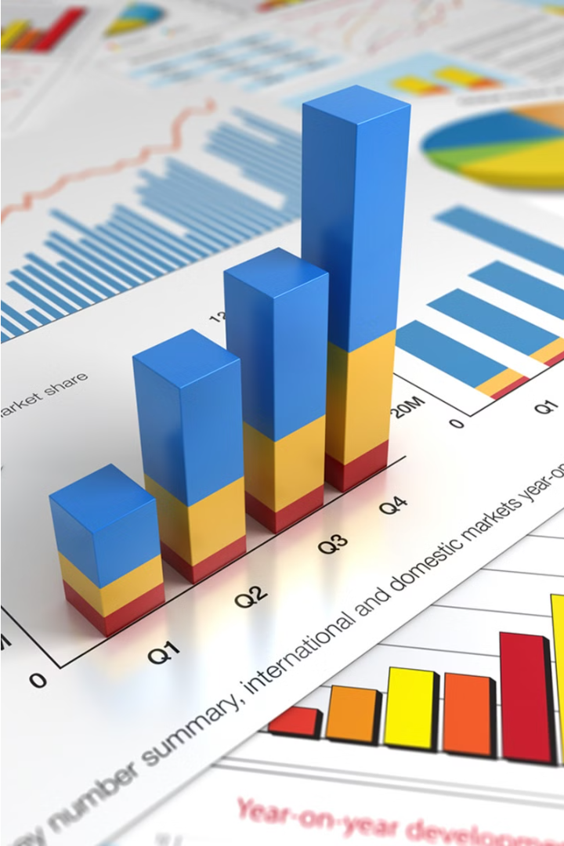

Financial Analytics Report
Market Capitalization and Quarterly Sales Analysis of Top 500 Indian Companies
by Shravani Chandane
Notes:
1

Slide 2


Project Overview
Objective
Dataset
Analyze the market capitalization and quarterly sales of the top 500 companies in India to identify key metrics and relationships.
Market Capitalization and Quarterly Sales data of top 500 Indian companies.
Notes:
2

Slide 3
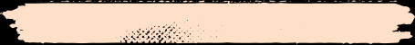


Key Metrics and Findings
553.82
₹5.83T
0.50
₹3,017.07C
Highest Ratio
Highest Average
Lowest Ratio
Lowest Average
Market Capitalization to Quarterly Sales Ratio
Market Capitalization
Market Capitalization to Quarterly Sales Ratio
Market Capitalization
The market capitalization to quarterly sales ratio ranged from 0.50 (Redington India) to 553.82 (SPARC), with SPARC having the highest ratio and Redington India the lowest.
The highest average market capitalization was ₹5,83,436.72 Crores for Reliance Industries, while the lowest was ₹3,017.07 Crores for National Fertilizers. The total range in market capitalization was ₹3,017.07 to ₹5,83,436.72 Crores.
The highest sum of quarterly sales was ₹1,10,666.93 Crores for IOCL, with the overall range being ₹0 to ₹1,10,666.93 Crores.
Notes:
3

Slide 4

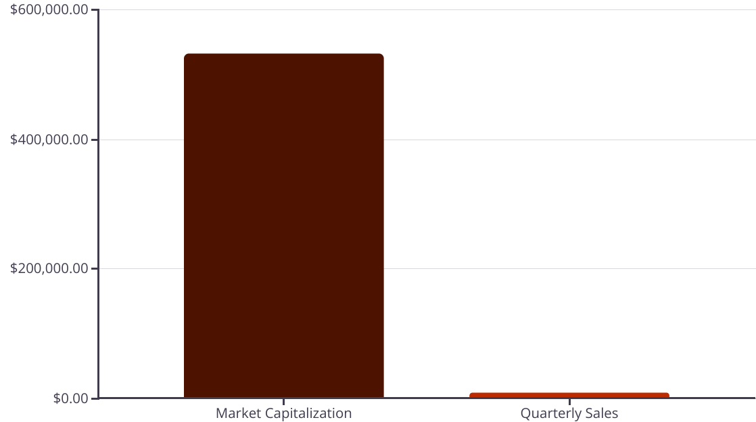
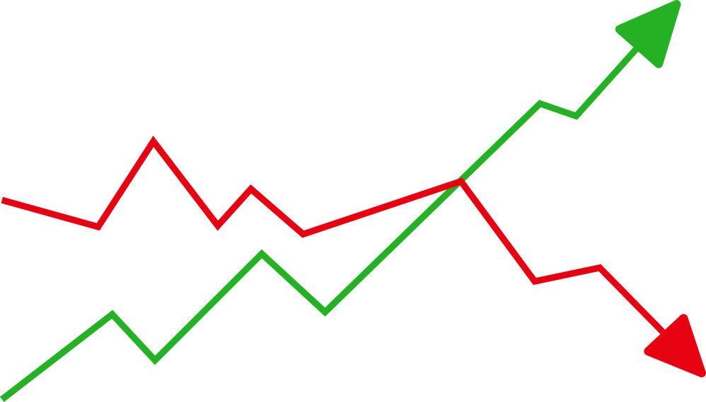
Detailed Findings
The analysis reveals a negative correlation between market capitalization and quarterly sales, indicating that as one metric increases, the other tends to decrease.
The company with the highest divergence between market capitalization (₹5,32,805.84 Crores) and quarterly sales is TCS.
Notes:
4

Slide 5


Specific Comparisons
SPARC vs. Redington India
Reliance Industries vs. National Fertilizers
SPARC's Market Cap to Quarterly Sales ratio is 1,10,055.95% higher than that of Redington India.
Reliance Industries' average market cap is 19,237.86% higher than National Fertilizers.
Notes:
5

Slide 6


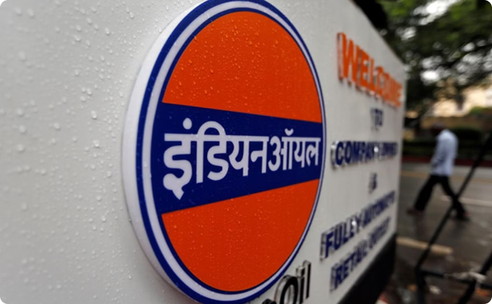
Summary of Top Companies
Top Companies by Market Cap
Top Companies by Quarterly Sales
Reliance Industries and TCS are the top companies by market capitalization based on the analysis.
IOCL and Reliance Industries are the top companies by quarterly sales based on the findings.
Notes:
6

Slide 7
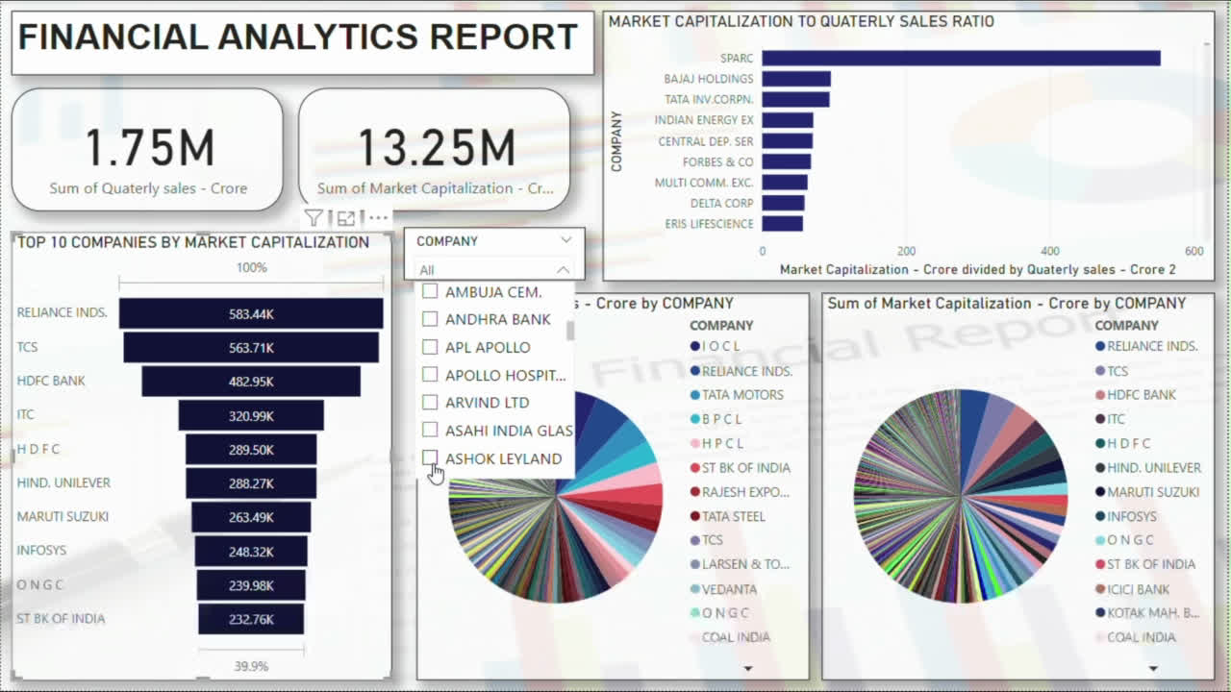
Power BI Report
Notes:
9

Slide 8

Conclusions
1
Diverse Market Performance
2
Negative Correlation
3
Influential Outliers
Significant variance in Market Cap to Sales ratios among companies indicates diverse market performance.
Negative correlation between average market cap and quarterly sales suggests higher market cap does not necessarily translate to higher sales.
Outliers like SPARC, TCS, and Reliance Industries significantly influence overall metrics, pointing to their unique market positions and strategies.
Notes:
7

Slide 9





Strategic Recommendations
Focus on Sales Growth
Cost Management
Investor Relations
Innovation and R&D
Implement strategies to boost sales and align with market cap valuations, such as diversifying product lines or expanding market reach.
Optimize operational costs to improve profit margins and support sales growth for companies with high market cap but low sales.
Strengthen communication with investors to highlight growth potential and sales performance for companies with high sales but low market cap.
Invest in research and development to introduce innovative products and services that can enhance market perception and increase market capitalization.
Notes:
8

Slide 10
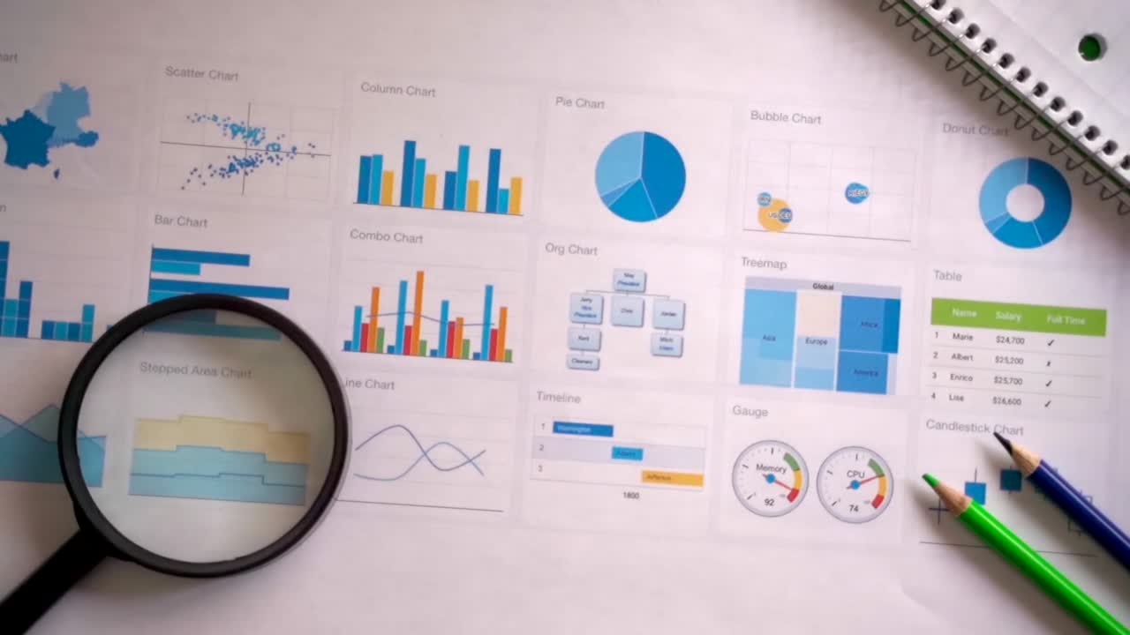


Thank you!
GITHUB
LINK
LINKEDIN
LINK
Notes:
9

